Slide 1

Living
Consumer
Intelligence
business.yougov.com

Slide 2

WHAT WE DO
We help the world’s most recognized brands, media owners and agencies to
explore, plan, activate and track
better marketing activities ​

Slide 3











A few of our clients
OUR SUCCESS STORIES

Slide 4

Get the richest and most complete understanding of your customers’ complex lives
HOW WE CAN HELP
4
Notes:
Free Image from Unsplash

Slide 5

We have been building an ever-growing source of connected consumer data for the past twenty years.
We call it…
WHAT MAKES US DIFFERENT
living data​

Slide 6
WHAT MAKES US DIFFERENT
What is living data?
Input
Output
Loyalty | Awareness
Streaming data | Lifestyle
Customer status | Media habits
Online behavior | Financial data
Demographics | Purchase intent
Opinion tracking | Polling
Audience intelligence and targeting
Campaign activation
Brand and campaign tracking
In-depth custom research
Omnibus surveys
Quick surveys and polls
Self-service research
Living
data
An ever-growing data hub of intelligence collected daily on 22m+ registered panelists powering our connected products and platforms

Slide 7

WHAT MAKES US DIFFERENT
Living data underpins our broad suite of products
Plan
Audience intelligence and targeting
Activate
Campaign activation
Track
Brand and campaign tracking
YouGov
Profiles
Extensive profiling database of thousands of consumer metrics.
YouGov
Safe
Verified, permissioned online consumer behavioral data.
YouGov
Global Profiles
Unrivalled global consumer intelligence across 48 markets
YouGov
Audience Data
Addressable audiences
Available for ad targeting.
YouGov
BrandIndex
Daily brand tracking of brands around the globe.
YouGov
Stream
First ever streaming SVOD & AVOD data across multiple platforms.
YouGov
Custom Trackers
Dynamic, integrated performance monitoring.
YouGov
Re-Contact
Target specific previous survey respondents.
YouGov
Chat
Nurture communities and contact niche audiences with interactive chat.
YouGov
Global Sector Profiles
Tailored sector intelligence:
Global Automotive Profiles
Global Fan Profiles
Global Gambling Profiles
Global Travel Profiles
Telco Profiles
YouGov
FreeWall®
Engagement-led
digital advertising.
YouGov
Signal
Social listening platform monitoring conversation and sentiment online.
YouGov
Consumer Journey Diagnostics
Templated brand research at specific customer journey touchpoints.
YouGov
Sector Indexes
Tailored daily tracking for your sector:
CharityIndex
CultureIndex
DestinationIndex
GameIndex
SportIndex
Explore
Quick surveys and polls
In-depth custom research
YouGov Surveys:
Self-serve
24/7 research platform with results in minutes
YouGov Surveys:
Serviced
Fast omnibus and targeted surveys with researcher support
YouGov
Custom Research
100% bespoke market research with full end-to-end support.

Slide 8

WHAT MAKES US DIFFERENT
Living data
An ever-growing source of constantly evolving, connected intelligence:
discover what your customers were thinking yesterday, 5 years ago, and today.
WHAT MAKES US DIFFERENT
We build tailored, end-to-end solutions for the most
effective strategy and marketing activities
Explore
Answers you need from your audience – from syndicated data and in-depth custom research to quick surveys and polls.
Explore
Plan
Plan
Unlock the most complete profile of your audience, with over a million data points.
Living data
Activate
Supercharge campaigns with precision targeting and unmissable advertising.
Activate
Track
Continuously monitor what your audience thinks about
brands, campaigns and your competition with daily updates.
Track

Slide 9


What our clients say
OUR SUCCESS STORIES
“YouGov was
startlingly effective…
Their model worked
astoundingly well”
Notes:
Image from Google search

Slide 10
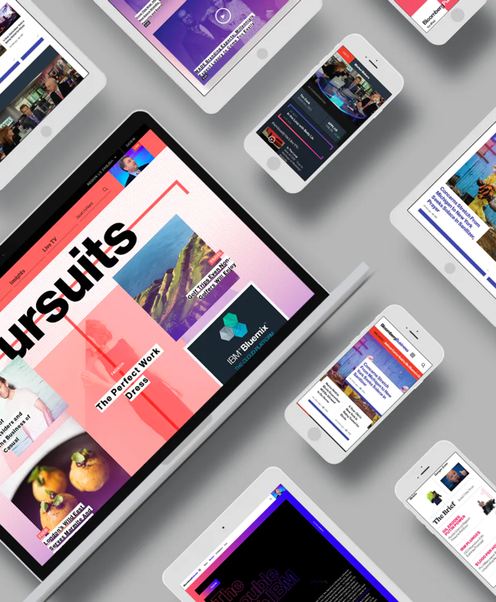

What our clients say
OUR SUCCESS STORIES
“The YouGov model is more than a poll. It's a hybrid
of a traditional opinion survey and an exercise
in big data analysis”
Notes:
Image from Google search

Slide 11
YouGov in numbers
OUR REACH
40
+
million surveys carried out yearly
22
+
million registered panel members
15
+
years of historical brand data

Slide 12
In over 55 markets
OUR REACH
Partner and affiliate panels
YouGov panels

Slide 13

Why work with us?
13
Notes:
YouGov image

Slide 14
Speed
WHY WORK WITH US
Direct access
to 22 million+ registered panel members
Full product suite to support all strategic or tactical business challenges
Cloud-based to enable quick sharing and collaboration across
your business
Dashboards and interfaces to build and view the data you need

Slide 15
Certainty
WHY WORK WITH US
Compare data over time, territories and over hundreds of datapoints
Explore connections to get both the bigger picture and all the detail
Re-Contact the
same panel members
to dig deeper

Slide 16
Integrity
WHY WORK WITH US
Our registered panel members are constantly and extensively verified
Pew Research Center recognizes that YouGov “consistently outperforms competitors on accuracy”
Our data is regularly referenced by the press worldwide and we are the most quoted market research source in the UK

Slide 17

Case
studies
17
Notes:
Image used:
https://www.istockphoto.com/photo/happy-woman-using-mobile-phone-on-sofa-gm516008710-88777211

Slide 18



CASE STUDY:LIVING DATA PLATFORMS
Molson Coors
How Molson Coors used YouGov’s living data to retrospectively measure the impact of their organic inclusion in Netflix’s Cobra Kai
“Being able to tap into YouGov’s suite of products allowed us to evaluate and directly attribute the increase in brand awareness for Coors Banquet
to its exposure in the Cobra Kai series on Netflix.
Using YouGov BrandIndex for brand health tracking, combined with YouGov Profiles for consumer media behaviors, unlocked a powerful insight that we would not have been able to get otherwise.”
Matt Slater
Senior Manager, Marketing Insights at Molson Coors
Notes:
YouGov image

Slide 19


CASE STUDY:LIVING DATA PLATFORMS
Challenge
Solution
Result
A Molson Coors wanted to investigate impact on brand awareness after Coors Banquet beer was featured organically on Netflix’s Cobra Kai.
They needed:
To understand pre- and post-exposure levels of awareness for the product
A clear and accurate analysis of their overall brand health
A trustworthy source of data to inform, future strategy based on the results
YouGov’s living data and historical data helped analyze brand awareness amongst Cobra Kai viewers and how it had changed:
YouGov Profiles was used to identify the target audience. Examine their media consumptions habits, and identify which
were viewers of the show
YouGov BrandIndex was used to analyze levels of brand awareness in viewers of the show vs non-viewers
Tracking audiences pre- and post-viewership, Molson Coors successfully identified an increase in brand awareness of Coors Banquet.
The brand awareness analysis demonstrated a definitive positive correlation:
73% higher brand awareness among Cobra Kai viewers vs non-viewers
Molson Coors now used both YouGov BrandIndex and YouGov Profiles across multiple of their business units and brands

Slide 20
Thank you
For more information go to business.yougov.com
Or contact xxx.xxxxxx@yougov.com

